Slide 1
Study on Involuntary Denial Boarding and Air Traffic Landing in United States
Database & Analytics Programming (MSCDAD_A)
Abhilash Chava (21178712 )
Christy Lyona Joseph Vijayan (21202583)
Jyothirmai Myneni (21235325)
Sagar Madenoor Chandrakumar (21185107)

Slide 2
Abstract— This study aims to understand the rise in denied boarding and difficulties with air traffic landings in relation to the growing air traffic and the airline challenges. Using ETL (Extract Transform & Load) and visualization techniques, the data pertaining to airlines, passengers, denied boarding, and aircraft landing information is examined to ascertain any relation between the attributes across the datasets. All the datasets are related and for the travelers from United States. Third quarter had the most passengers travelled

Slide 3

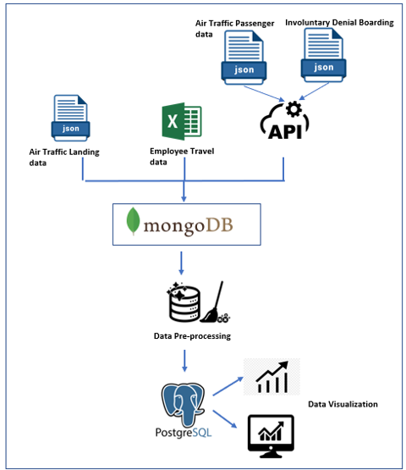
Project Flow
Step 1 : Reading source data
Step 2: Load data to Mongo DB
Step 3 : ETL
Step 4: Load data to PostgreSQL
Step 5: Data Visualization

Slide 4
Data Set 1
Air traffic Passenger Statistics data from 2005 to 2020 (US data gov website)
Data is about Monthly Passenger Statistics by Airline at San Francisco International Airport
Transformations used - Removing null values and duplicates, changing the data types.
Data loading - Source → Mongo DB (ETL) → Postgres server
Visualization: Column charts (Passenger count over the years), Pie chart (Top 5 highest Passenger counts), Line chart (Passenger count over the years)

Slide 5
Data Set 2
Employee Travel Data (Non-Local) from 2015 to 2022(US data gov website)
Details the total actual expenses incurred by Montgomery County employees that travelled for work purposes
Transformations used - Removing null values and duplicates, changing the data types.
Data loading – Source → Mongo DB (ETL) → Postgres server
Visualization: Map(Most traveled countries by Passengers), Heat Map(Passenger count in each month and year), Pie chart (Passengers count based on purpose of travel)

Slide 6
Data Set 3
Commercial Aviation - Involuntary Denied Boarding data from 2010 to 2021 (US data gov website)
This dataset contains the airlines details, passengers and denial boarding count by month.
Transformations used - Removing null values and duplicates, changing the data types.
Data loading – Source → Mongo DB (ETL) → Postgres server
Visualization: Line Graphs(Total Denial Boarding over the months), Bar Graph(Operating airlines that paid maximum compensation), Bar Plot (Operating airlines that arranged alternate transport)

Slide 7
Data Set 4
Air Traffic Landings Statistics Data (US data gov website)
This dataset has the aircraft landing statistics of San Francisco International Airport and is available on US data gov site which is an open source
Transformations used - Removing null values and duplicates, changing the data types.
Data loading – Source → Mongo DB (ETL) → Postgres server
Visualization: Column Charts(Landed flights count based on type of air-craft), Line Graph(Average yearly total landed weight), Bar Plot (Distribution of aircraft body type)

Slide 8
Conclusion
This is a study about :
relation between the passenger count
activity period
Involuntary Denial Boarding
Finding the correlation
Analysis was also made for Air traffic landings where in major regions, landed weights based on the aircraft type and models.
Further study:
Predictive models may be created based on these variables
Saving airlines from having to deny boarding
Adverse effect on customer satisfaction

